Slide 1

Challenge 18:
🌿 Village Stay: Authentic Rural Tourism Marketplace

Slide 2
Team Details
Team Name | Village AI Innovators
Member Email id1[Lead] | mohammedazeem.azeez@infosys.com
Member Email id2 | harleen.sabherwal@infosys.com
Member Email id3 | shaik.salma04@infosys.com

Slide 3
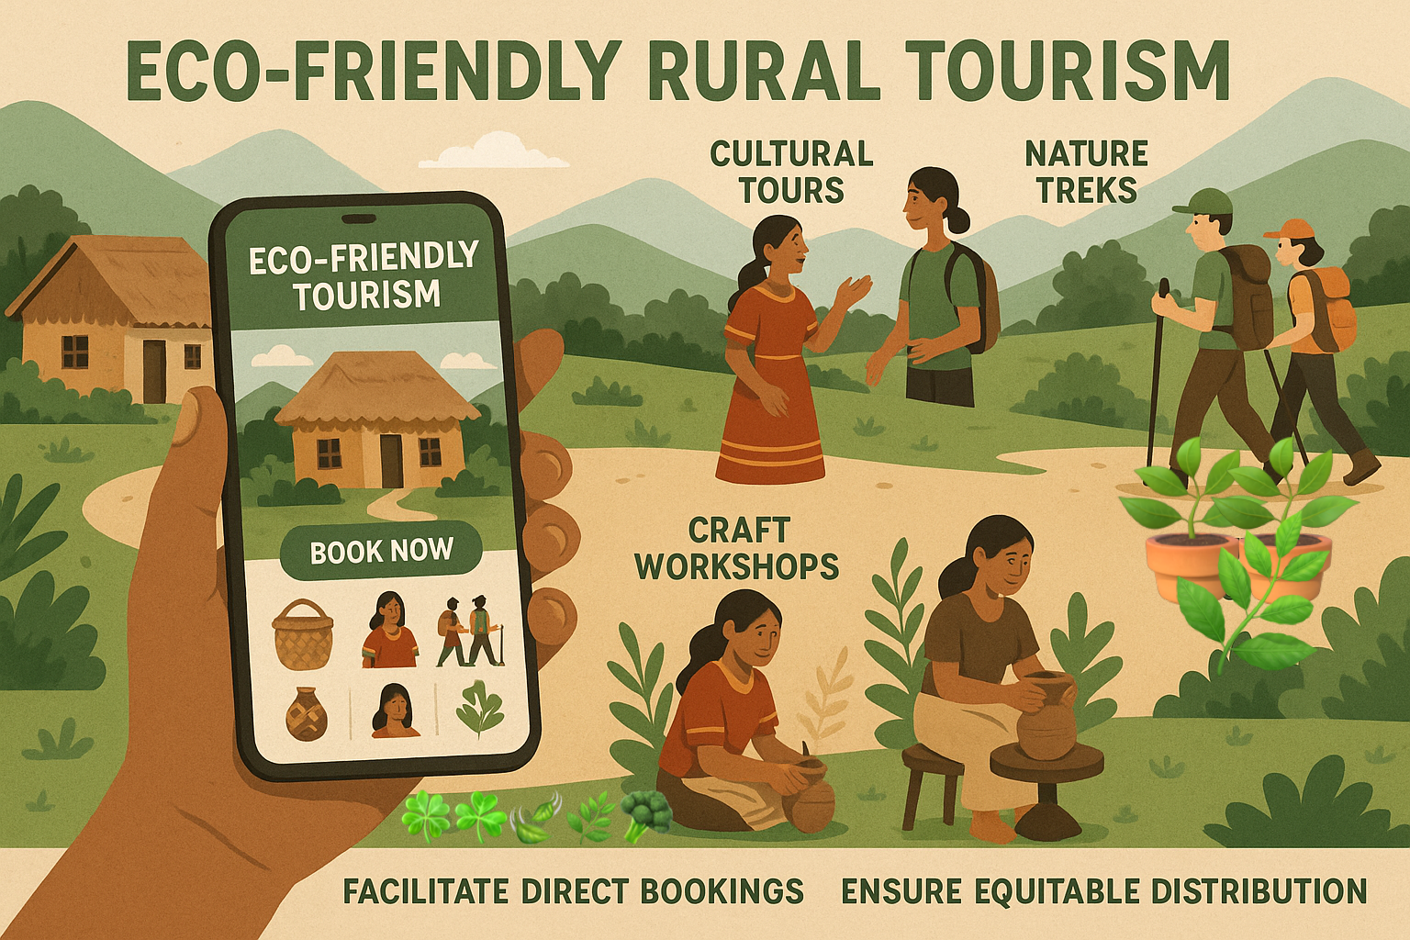
🛖 Problem :
Rural tourism locations throughout India are deficient in digital visibility and direct booking mechanisms, which restricts economic prospects for local communities, while traveler’s seek authentic experiences and
sustainable tourism options that benefit local populations.
Solution Plan :
🌱 Create an all-encompassing mobile and web application with advanced technology that highlights rural tourism experiences, facilitates direct bookings with the community, guarantees equitable distribution to local stakeholders, and advocates for sustainable tourism practices with an emphasis on cultural preservation.
🛖 Solution Approach:
AI-Driven Rural Tourism Platform Concept
Rural India’s tourism potential is hampered by limited online presence and fragmented booking channels. Studies note that “rural destinations often lack digital visibility”, with scarce information on transportation or lodging, making them seem inaccessible . Travelers today expect mobile tools, AI chatbots and local-language support to find and book offbeat sites . Our solution is a unified mobile/web app (with Android, iOS and Web interfaces) that showcases rural experiences, enables direct local bookings, and embeds AI-powered features for personalization, sustainability and cultural preservation.

Slide 4
🛖 Key Features
🌱 Discovery & Personalized Itineraries: The app lists rural attractions by category (heritage, nature/eco, adventure, farm/agri-tourism, crafts/festivals, etc.) and uses AI recommendation engines to tailor suggestions. For example, an ML model could suggest local homestays or tribal village treks when a user shows interest in culture or nature. Interactive maps and short videos (even VR/AR previews) help visitors “see” a village’s highlights before arrival.
🌱 Rich Multimedia Content: Each listing includes photos, 360° panoramas or augmented reality (AR) overlays that bring local culture to life. For instance, pointing the app’s camera at a temple ruin could trigger an AR reconstruction showing villagers performing historic rituals. Virtual reality (VR) tours can recreate seasonal festivals or artisan workshops now lost to time . These immersive previews spark interest in rural heritage and educate visitors.
🌱 Local Language & Chatbot Support: The platform uses NLP and speech AI to overcome language barriers . A built-in chatbot handles queries in Hindi, Tamil, Bengali, etc., translating between tourists and villagers. It can answer questions about local customs, farming practices or directions. Voice-based search (like asking “Where is the best village homestay nearby?” in a local dialect) and multi-lingual content make the app accessible to users.
🌱 Direct Booking Engine: Travelers can book homestays, guided tours, craft workshops and farm stays directly through the app’s secure payment portal. Integrated digital payments (e.g. UPI, mobile wallets) enable instant, cashless transactions . By removing big online travel agencies (OTAs), the app ensures all booking revenue goes to local hosts. As one social-enterprise founder observes, “direct bookings ensure 100% of the travel spend goes to local businesses and communities”.

Slide 5
🌱 Equitable Revenue Sharing: Bookings trigger transparent revenue splits. A configurable rule might allocate, say, 80–90% of each payment to the host family or village development, and the remainder to app maintenance. 🌱 Community Marketplace: Beyond stays, the app doubles as a marketplace for local goods. Artisans can list handicrafts, handlooms, organic produce or cookery classes. AI matchmaking suggests items based on visitor interests (e.g. recommending bamboo crafts to a traveler who enjoyed a forest trek) . This raises demand for traditional products, preserving techniques and generating income. The app can even connect tourists with farmers for a village lunch or organic farm tour, supporting sustainable agriculture . 🌱 Sustainability & Conservation Tools: In-app sustainability badges rate accommodations on eco-credentials (solar power, rainwater use, waste management). The AI monitors environmental data (e.g. crowding, waste levels) and suggests optimal itineraries to minimize impact . Users earn rewards or discounts for low-carbon choices (walking tours, bicycle rentals, community tree-planting activities). Educational tips highlight local ecology and conservation rules, helping preserve fragile ecosystems. For instance, an image of a wildflower or bird (leveraging on-device vision AI) could trigger information on local flora, enriching awareness of biodiversity. 🌱 Cultural Preservation & Storytelling: The app actively celebrates culture. It provides historical notes and folklore about each village site, promoting respect and understanding. AI-generated audio guides (in multiple languages) share local legends during tours. When visiting a tribal dance, traveler’s get background on its meaning and etiquette. The app also publicizes upcoming village events (festivals, fairs, craft expos) so visitors can participate. By making culture accessible but respected, the platform helps traditions stay vibrant. 🌱 Offline Capabilities: Recognizing rural connectivity gaps, the app caches key content (maps, booking receipts, guides) for offline use. Booking/payment sync when service returns.

Slide 6
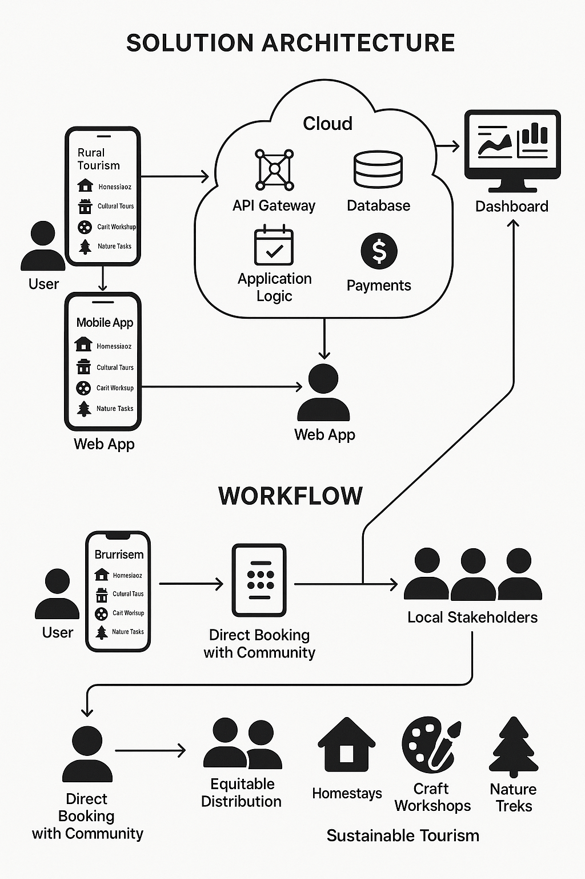
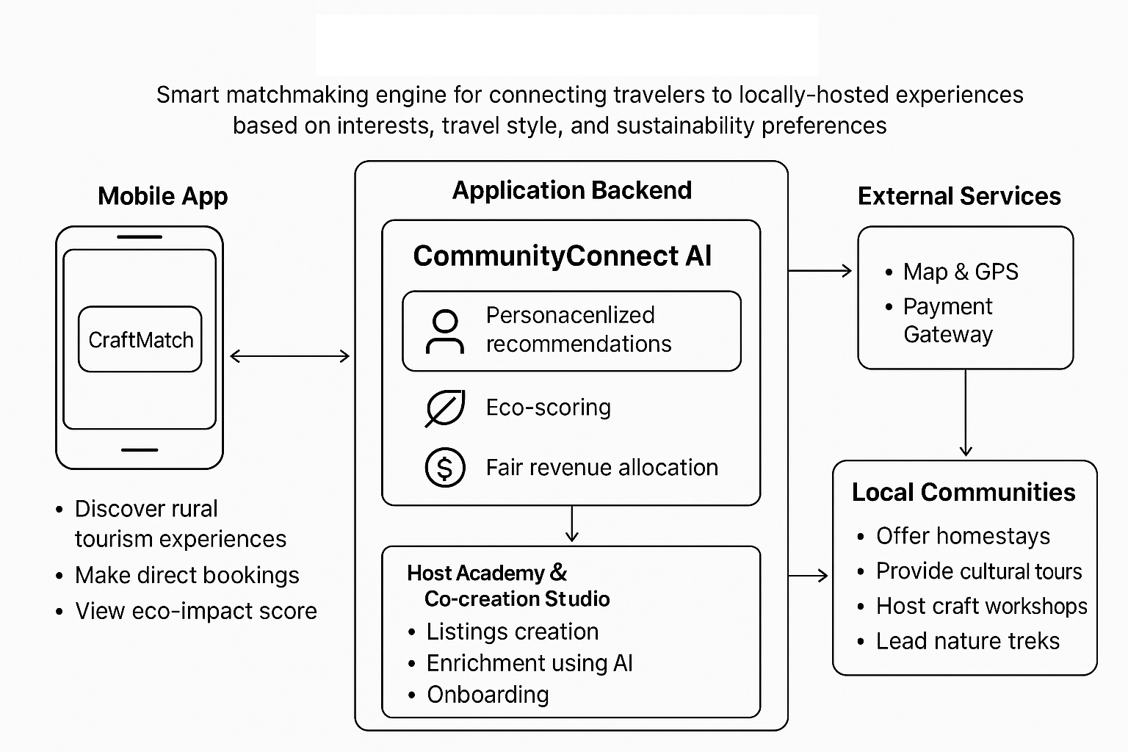

Slide 7
🛖 Technical outline
Technologies to be used in the solution: Web (ReactJS) & Mobile – (iOS & Android – Native or Cross )
This platform leverages several AI/ML components:
🌿 Machine Learning: Machine learning tailors suggestions to each traveler. Collaborative filtering and content-based algorithms match users with villages or experiences aligned to their profile . For example, if a visitor liked a tea plantation tour, the app might recommend an offbeat hill-village homestay known for gardens.
🌿 Natural Language Processing (NLP): AI understands queries and generates multilingual responses. It automatically translates host descriptions and user messages. Chatbots guide users through booking and can even do sentiment analysis on reviews (ensuring quality). Real-time voice-to-voice translation lets tourists converse with locals, easing cultural exchange.
🌿 Computer Vision & AR: On-device vision AI identifies landmarks or plant/animal species from photos, giving info on the spot. Combined with AR, it overlays annotations on real-time camera view: e.g. pointing at a mountain reveals its name and elevation. These immersive tools make learning active and fun.
🌿 Environmental Intelligence: Using sensor inputs and satellite data, AI models estimate a destination’s carrying capacity. It can warn if footfall exceeds sustainable limits. By tracking weather patterns, the app can pre-empt risks (monsoon flooding) and advise schedule changes.
🌿 Community-Sourced Intelligence: Locals contribute data on their schedules (festival dates, crop harvests). The AI learns patterns and alerts tourists to unique cultural experiences, ensuring traditions stay central to planning.

Slide 8
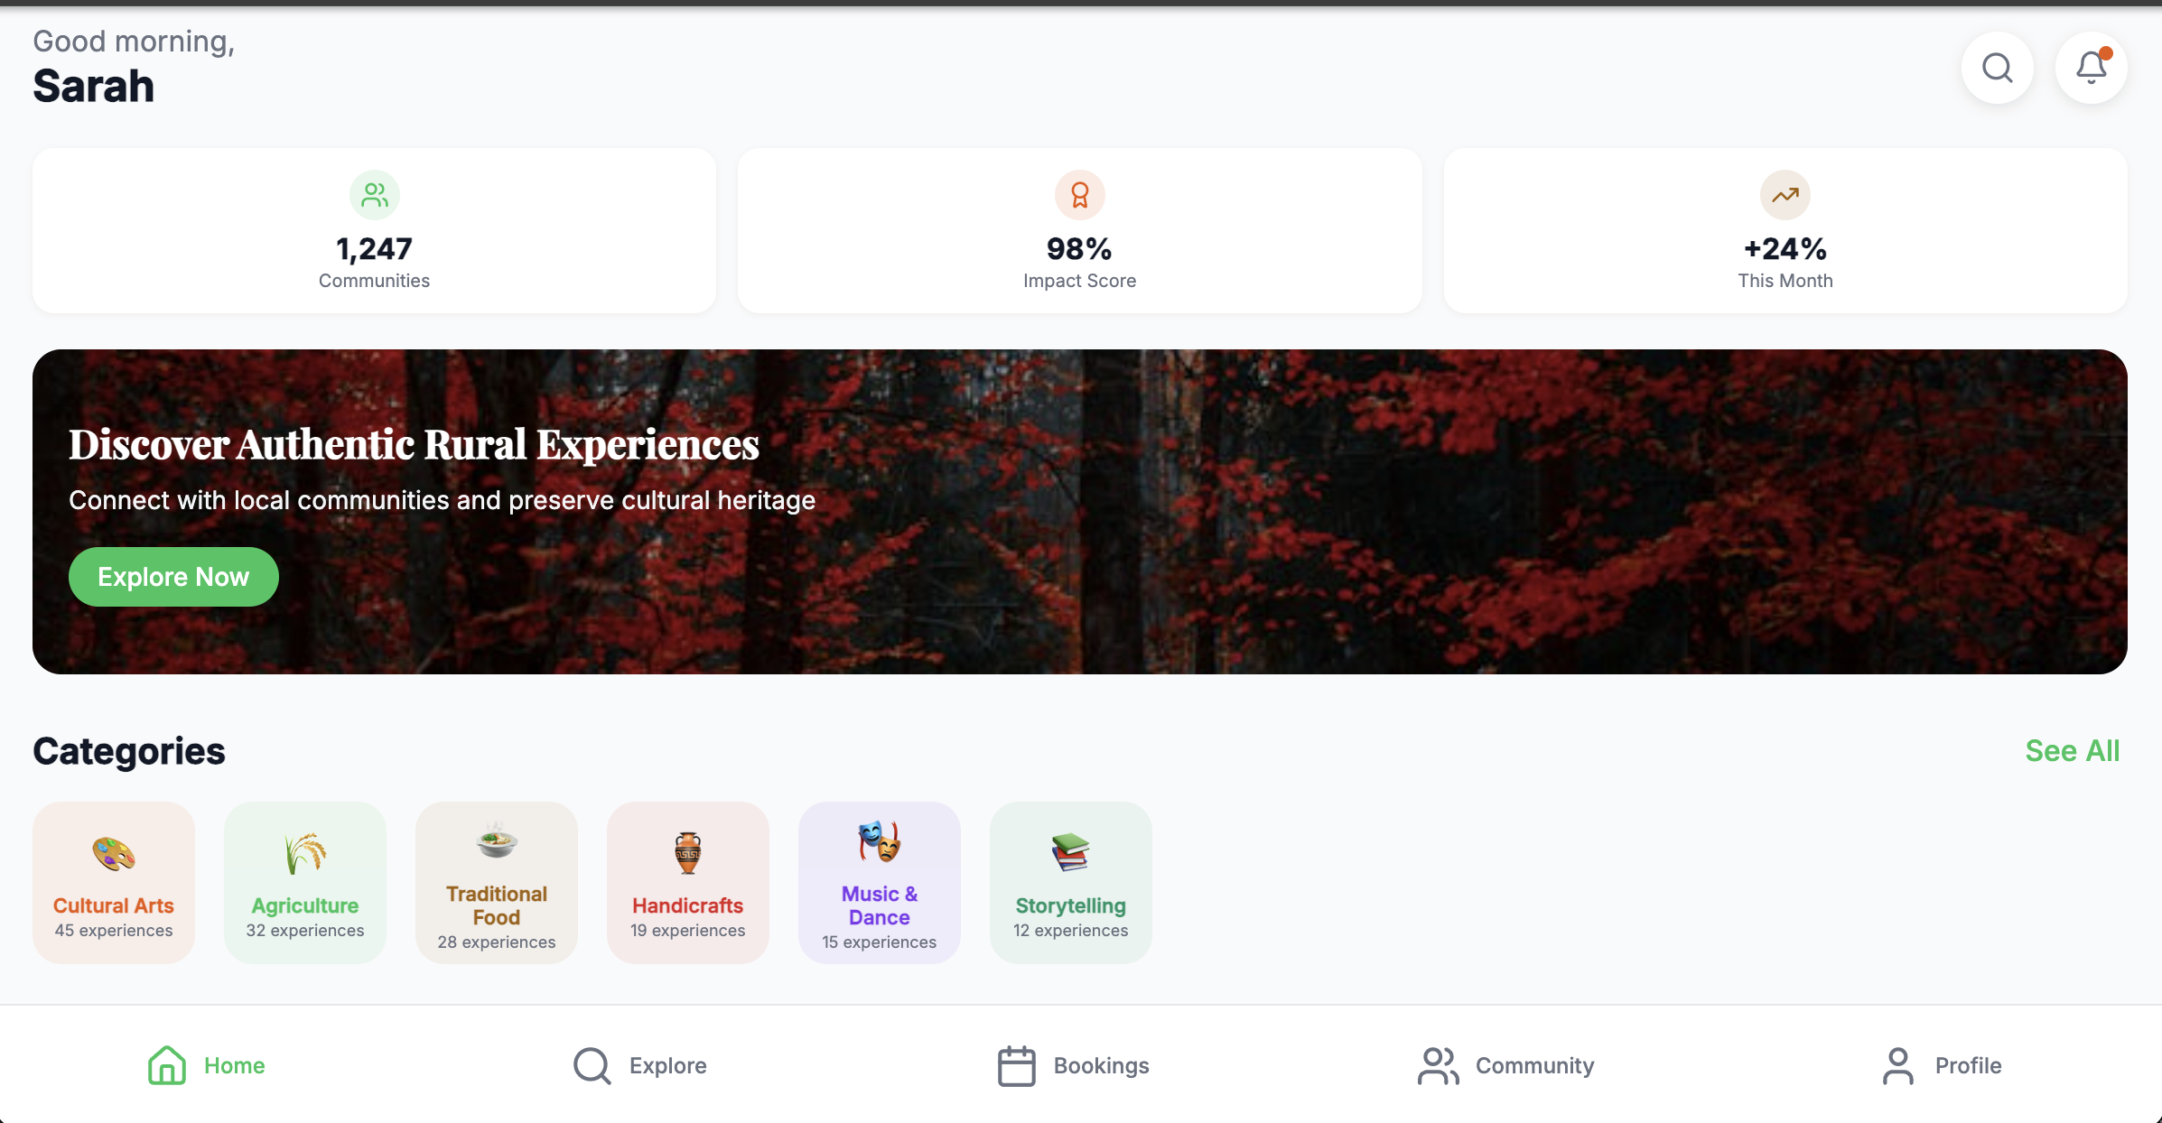
🛖 We have already started working with the solution – Web Application – Home Sample Screenshot attached for reference ..

Slide 9
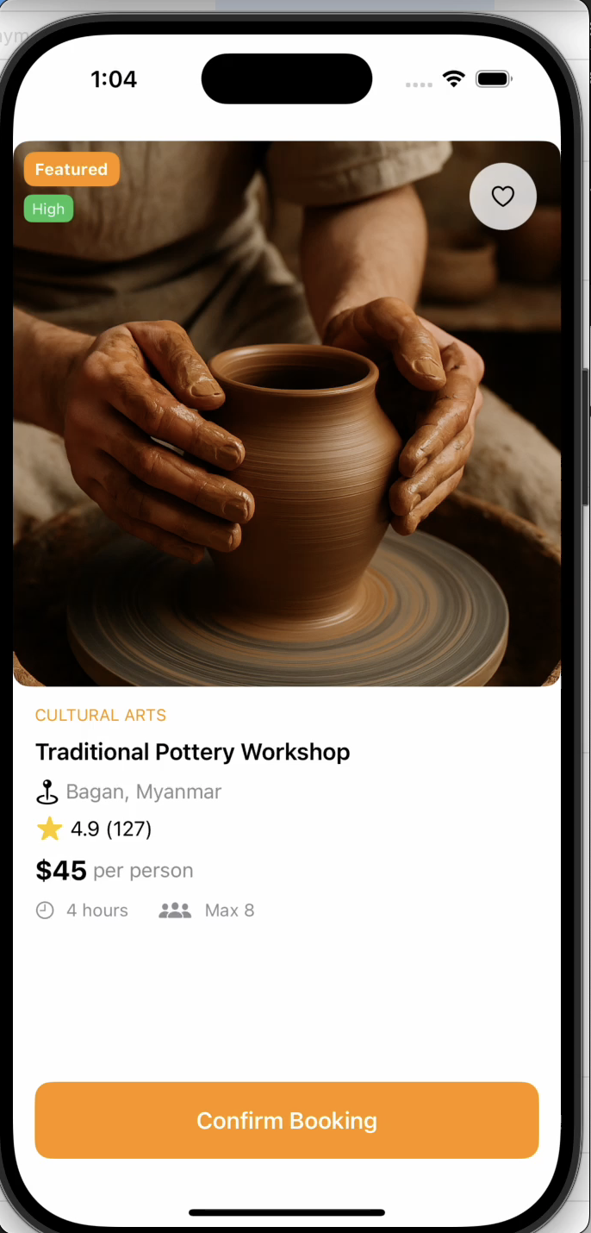
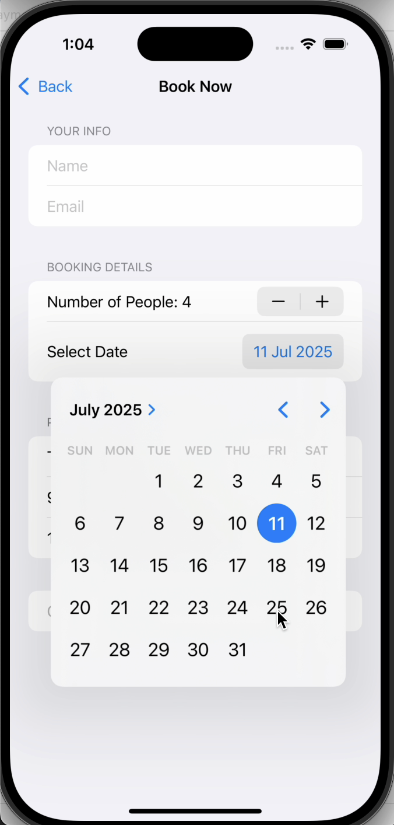
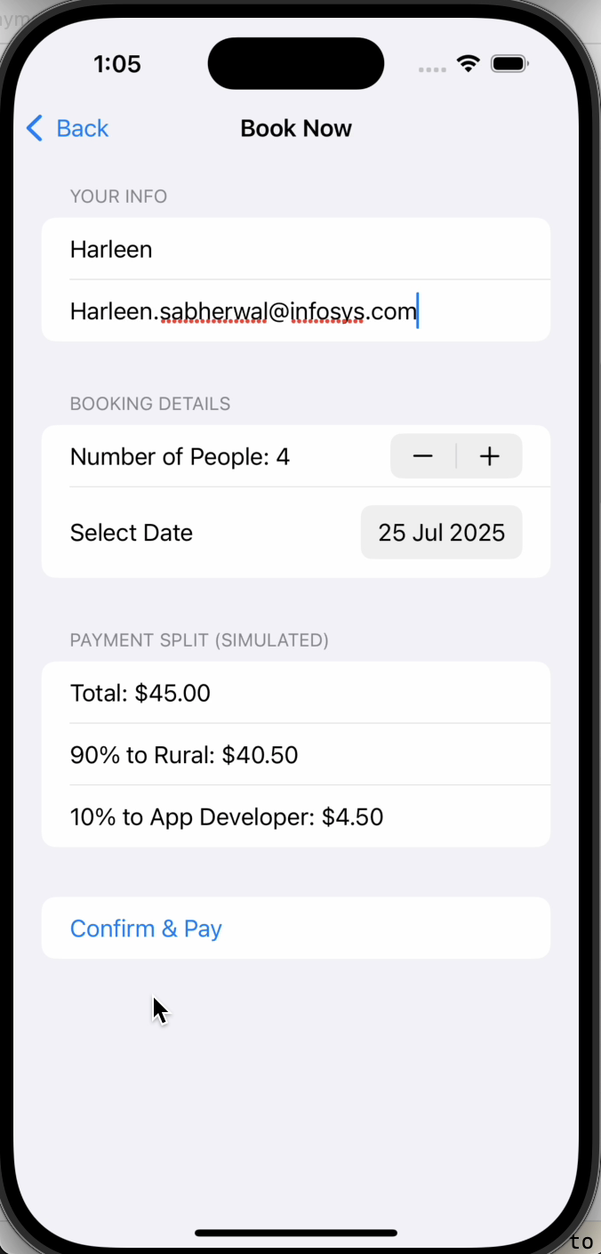
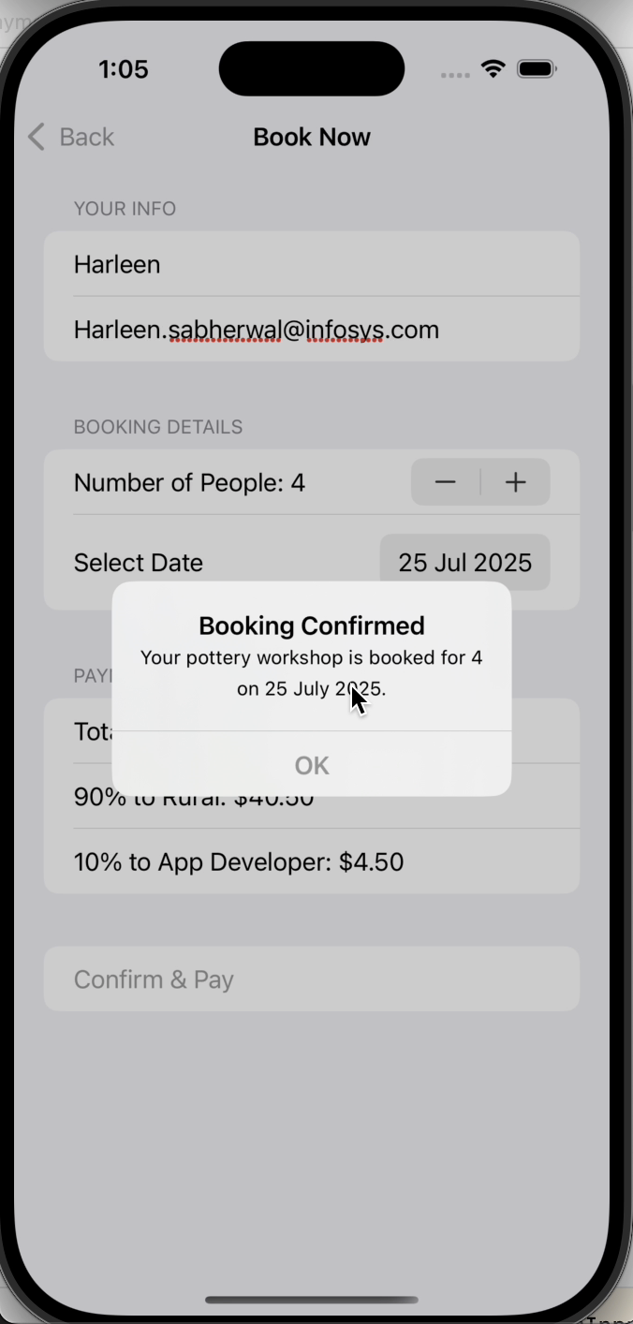
🛖 Solution development: Screenshots of native iOS Mobile App

Slide 10
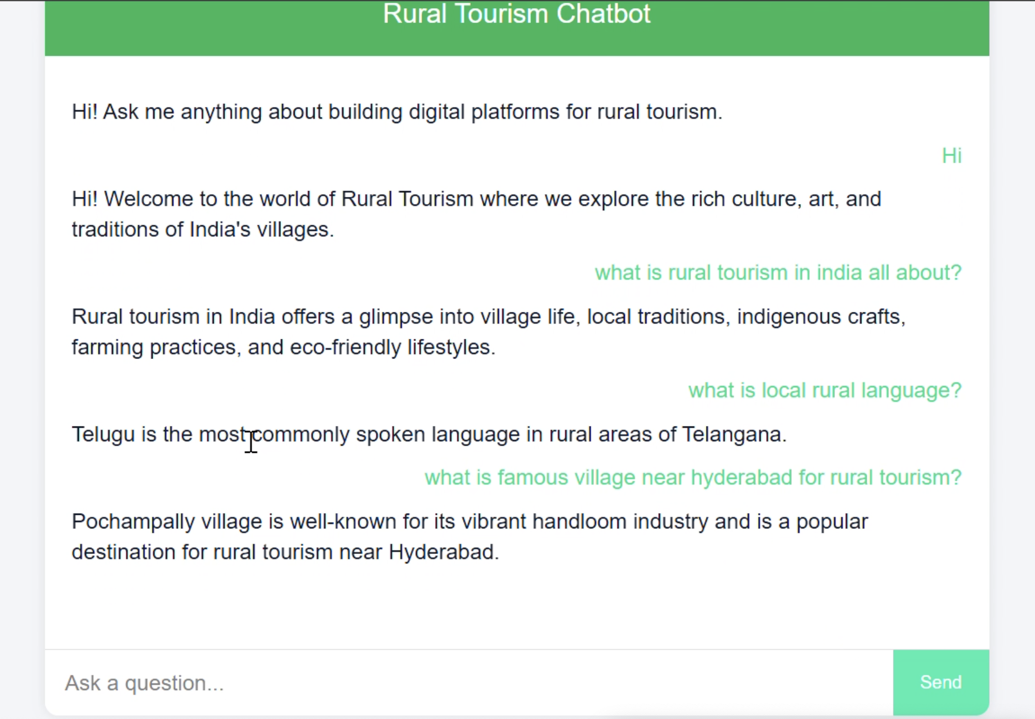
🛖 Custom model AI Chat Bot for Web Application, screenshot attached for reference ..

Slide 11
💰 Fair Share Wallet : Blockchain-based transparent payment system that auto-distributes tourism income fairly among hosts, guides, artisans, and community funds — reinforcing economic equity and trust. 🛖 Live Local Lens :AR-enabled cultural walkthroughs and audio guides created with local community members — allowing visitors to experience folk stories, rituals, and traditional knowledge through immersive storytelling. 📱 Offline First, Rural Ready : App architecture optimized for low-bandwidth rural areas using offline caching, progressive sync, and SMS-based booking support to ensure inclusivity in underserved regions. 🧶 Craft Match : A marketplace and booking platform for rural craft workshops and demos where artisans can list live sessions or pre-recorded tutorials — connecting culture preservation with skill-sharing tourism. 🌿 Eco-Impact Tracker : A dashboard that shows the sustainability score of each experience (based on energy use, waste, local sourcing) and offers eco-tips to tourists, while also gamifying green choices. 🧭 Local Trail Navigator: AI-powered nature trek planner that maps out eco-trails curated by villagers, offers GPS-guided treks, and identifies flora/fauna along the route with community-added insights. 🧑‍🤝‍🧑 Host Academy & Co-creation Studio : An in-app tool that allows rural hosts and community members to co-create their listings, add photos/audio in their native language, and get AI help for writing tour descriptions and pricing.
🛖 Novelty

Slide 12
🛖 Opportunities :
Equitable and Sustainable Impact
🛖 Conclusion: To ensure equity for local stakeholders, the app’s governance includes village councils or cooperatives. Training programs (possibly AI-driven tutorials) teach hosts digital literacy and hospitality skills. Communities set rules (for example, a code of conduct for guests) that AI enforces through automated messaging. This follows the recommendation to “keep tourism spend local that can contribute the economic foundation vital for ecological, cultural, and social sustainability” .
Opportunity to work closely with NGOs and tourism boards, the platform aligns with the National Digital Tourism Mission goals of expanding internet reach and unified booking systems.
🌿 Sources: Industry and academic analyses on rural tourism and AI inform this design; field studies urge improved digital visibility and booking tools for villages ; success stories like rainmaker.travel or Earth5R demonstrate that “attracting direct bookings” via digital platforms empowers local hosts and keeps revenue local . All app features align with these insights for a sustainable, community-centric solution.
# Credit goes to OpenAI.com for images and sample web app layout
# Native iOS App and Web chatbot designed and developed by us from scratch
# Oracle Cloud

Slide 13
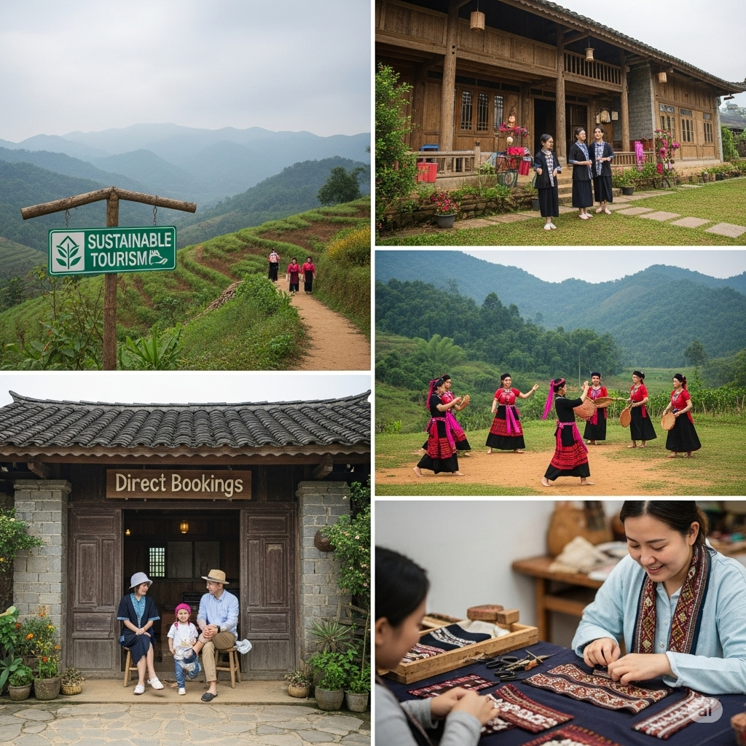
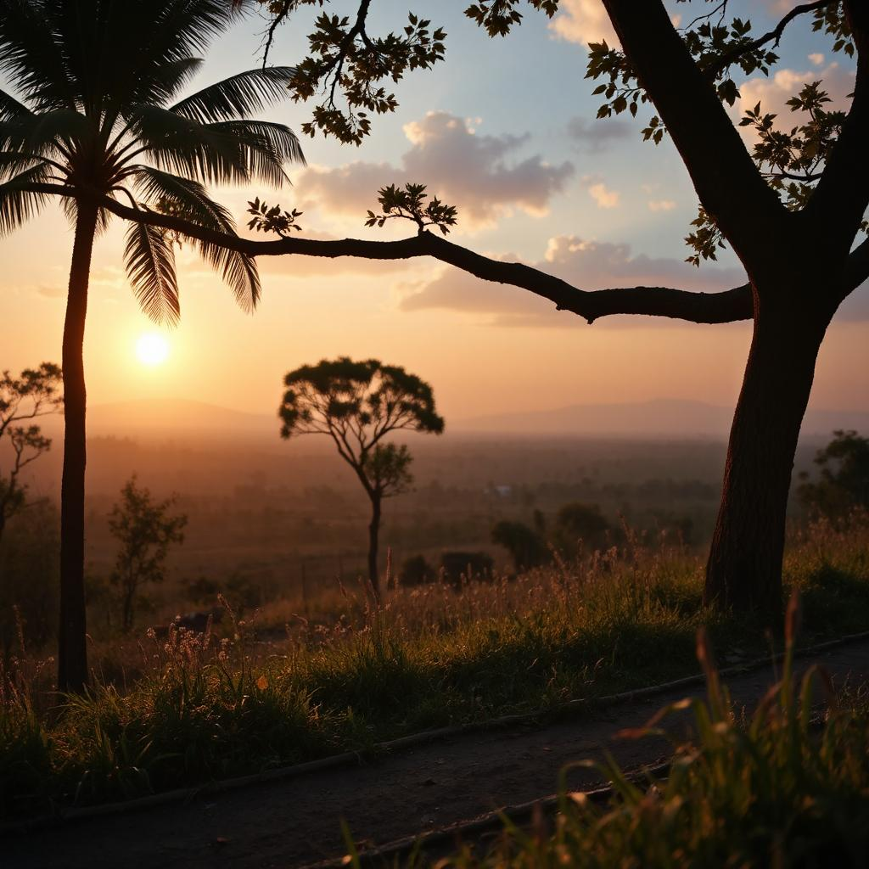
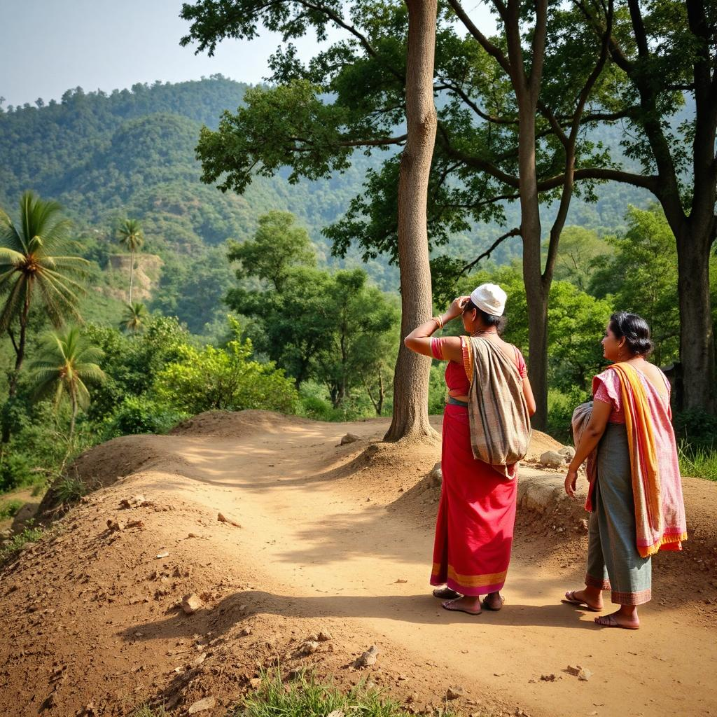
The End :– It’s just the beginning of new Tech era……

